Slide 1
Dynamic Auctions in Cloud using Bank Account Mechanism
P. Suryapratap
Prasun Joshi

Slide 2
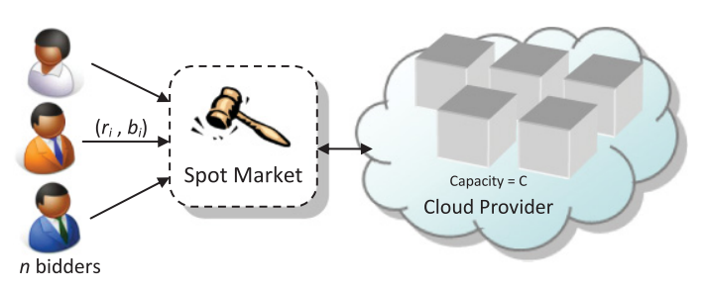
Auctions of Cloud Resources
IaaS
Amazon EC2 Spot Instances
AdWords

Slide 3

Auction Mechanisms
Static auction:
  One bid is submitted for each project, and the auctioneer then evaluates all bids.
  Bidders do not know the bids submitted by their competitors.
Dynamic auction
  Bidding takes place over several rounds.
  Bank account mechanism

Slide 4
Auction
Flow

Slide 5
Milestones
Date | Milestone
20 / 08 / 2018 | Understanding algorithm Gap Analysis Architecture and Flow
03 / 09 / 2018 | - Gathering Data UI
17 / 09 / 2018 | - Implement algorithm with data

Slide 6
Thanks!

